Slide 1

ED-JOY
Learn better
01

Slide 2

Today's Presentation
-Annanya Chaturvedi
-Faith Bijoy
-Shaswati Mohanty

Slide 3


The Joy of learning
Learn
Ed Joy makes the process of learning fun with animations and interactive quizzes.
Quiz time
Ed Joy incorporates games that are not only fun but helps to revise concepts and improve their knowledge.

Slide 4


Why Ed-Joy?
Through Ed-Joy, students can not only learn concepts but also revise them through fun games. Ed-Joy might become the medium through which kids these days might find an interest in studies. Clearing levels, achieving high scores, and unlocking new features is a big achievement for kids these days. Through these games, we hope to make education fun.

Slide 5

A 21st Century World
Learning is a continuous process and the focus has now completely shifted to eLearning. What we learn with interest, we never forget. Ed joy makes the process of learning fun by in- cooperating animations and cartoons as well as games which is perfect for the next alpha generation.

Slide 6
The Features of Ed- Joy
Animated learning
Kids will be taught with the help of fun cartoon characters and animations.
Games with Quizzes
Play and learn with interesting
quiz games on different
.
subjects.
Interactive way of learning
Technology meets learning! Active engagement of students will help them remember more.

Slide 7

About the Game
Ed-Joy mainly focuses on the age group from 5 to 12 years. The students have an option to select the respective grade as well as the subject for e.g. English, math, science, etc.
The student will be given the option to either learn or accept different challenges by giving various quiz of different levels.
Ed Joy is different from other learning platforms as we teach with the help of cartoon characters which makes students enjoy the learning process and also understand better.
The quizzes are unlike any type of test or exams, they are basically challenges. The students have to play a game and answer the asked questions rightly to get boosters, score points, and increase levels.

Slide 8


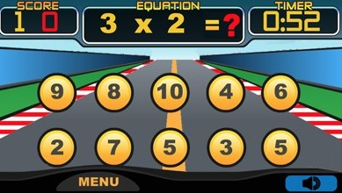
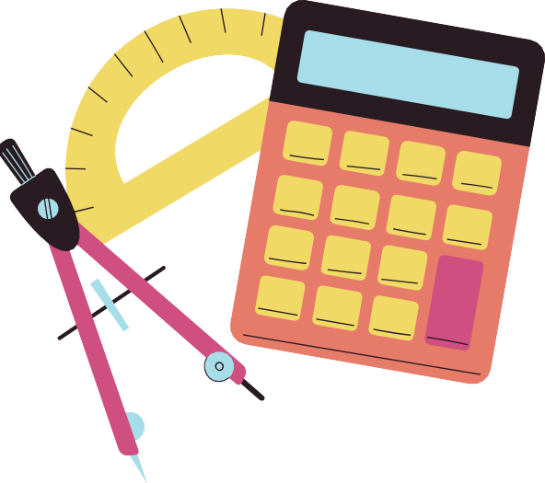
MATH
Improve your math skills with this application.
Fun games that will be a challenge and at the same time you will see how your results improve, you can also compare your scores with the rest of the users.
You can also configure a game as you want to practice what you like or have more difficulties (addition, subtraction, multiplication, division, exponents, square root ...)
Practice for a few minutes a day to get better results.

Slide 9




ENGLISH
Learning a language can be exciting but the real problem is when vocabulary and grammar comes into picture. Ed-Joy will help you learn the language with cartoon charecters and even more with the games like INTO THE UNKOWN .
The game includes mysteries which can be solved by answering simple questions which are not only fun but helps a lot in improving the language skills.

Slide 10



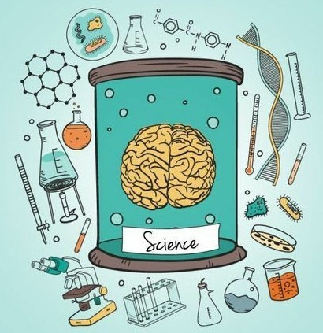

SCIENCE
Science is all around us. Have fun learning with these cool science games. Learn about chemistry, elements, seasons, animals, cells, life cycles, and more. We encourage kids to explore early science concepts and reinforce skills.
Memorize all concepts of science through a card game where you match the description with the correct image.
The game called 'FlipFlop' is an interactive way to remember your Science concepts. FlipFlop: A new approach to the old memory game!

Slide 11
Why is Ed-Joy Unique?
The app not only makes the student understand concepts but also helps them practice it in a very fun way. The learning process is made enjoyable by teaching the students with the help of cartoon characters. Interactive question and answers are also asked during the animated videos to ensure they understand the concept well.
The games too are unlike any other educational games as they include common games such as car racing, solving mysteries, matching cards, etc.

Slide 12

Thhhaaannnkkk
yooouuu!!!

